Slide 1
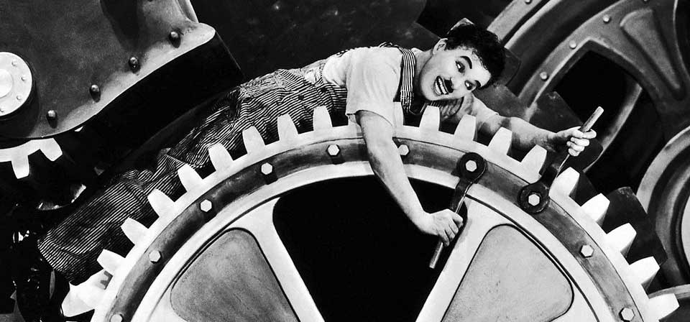
6.4 Artisanal, modern and contemporary industries
Notes:
1

Slide 2
6.4 Artisanal, modern and contemporary industries
From a historical point of view manufacturing of raw materials can be divided into different periods:
Before 1770: Artisanal industry
1770-1950: Modern industry
1770-1850: First industrial revolution
1850-1950: Second industrial revolution
1950-nowadays: Contemporary industry (Third industrial Revolution)

Slide 3
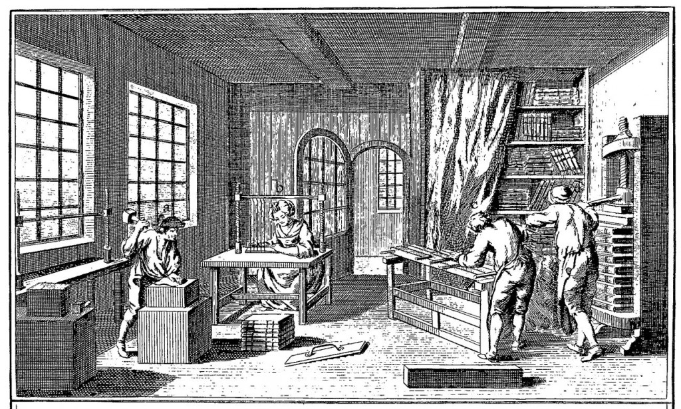
6.4 Artisanal, modern and contemporary industries
Before 1770: Artisanal industry
Artisanal industry was undertaken by hand, with traditional tools and animal or human energy sources.
Artisans worked in small
workshops and created
unique products.
It was located in the
center of the cities.

Slide 4
6.4 Artisanal, modern and contemporary industries
1770-1850: First industrial revolution
Modern industry appeared in Great Britain. Steam machine was the most important improvement. Coal became the most used energy source.
Manufacture was undertaken in factories out of the city center and the products were abundant, cheap and homogenous.

Slide 5
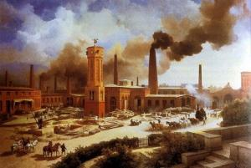
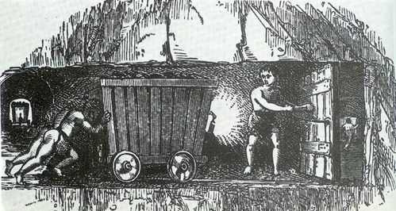
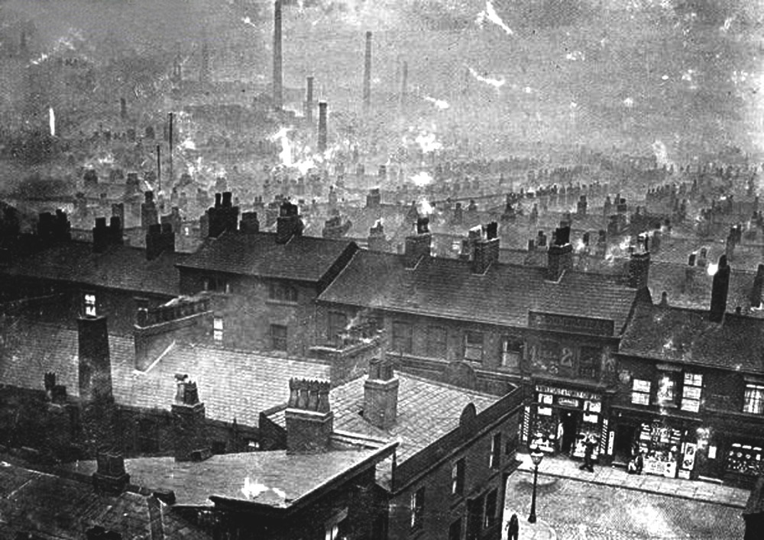
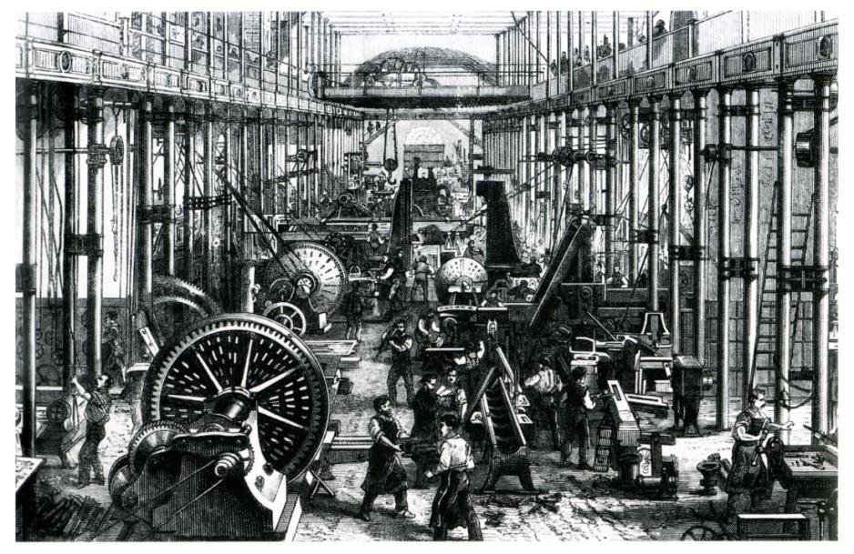
6.4 Artisanal, modern and contemporary industries

Slide 6
6.4 Artisanal, modern and contemporary industries
1850-1950: Second industrial revolution
In the mid 19th metallurgy and chemical industries developed in Europe.
Electricity started to be the main power force in factories and energy sources like oil became important for the industrial activity.
Industries were concentrated in the outskirts of the big cities in industrial estates.

Slide 7
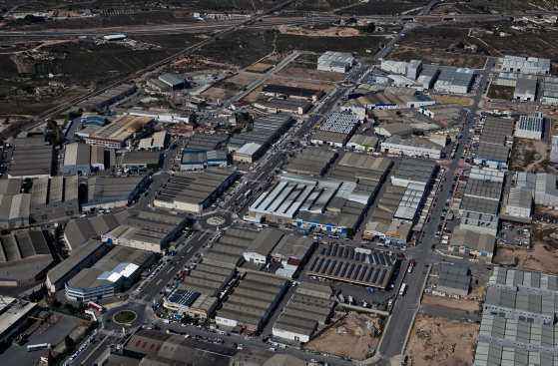
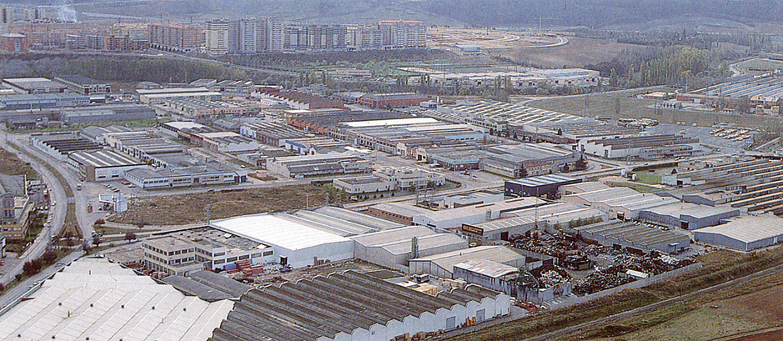
6.4 Artisanal, modern and contemporary industries

Slide 8
6.4 Artisanal, modern and contemporary industries
From mid 20th century: Contemporary industry
The innovations that led to the Third Industrial revolution were:
New technologies: microelectronics, computer systems…
Industrial robots
New materials
New energy sources: nuclear and renewable
New industrial sectors: telematics, aeronautics, biotechnology…

Slide 9
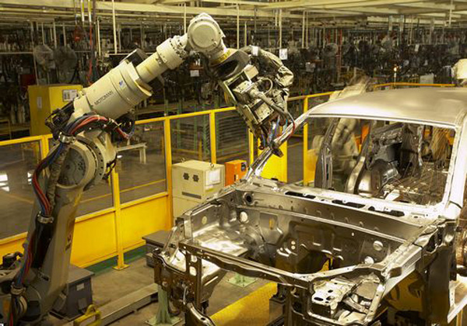
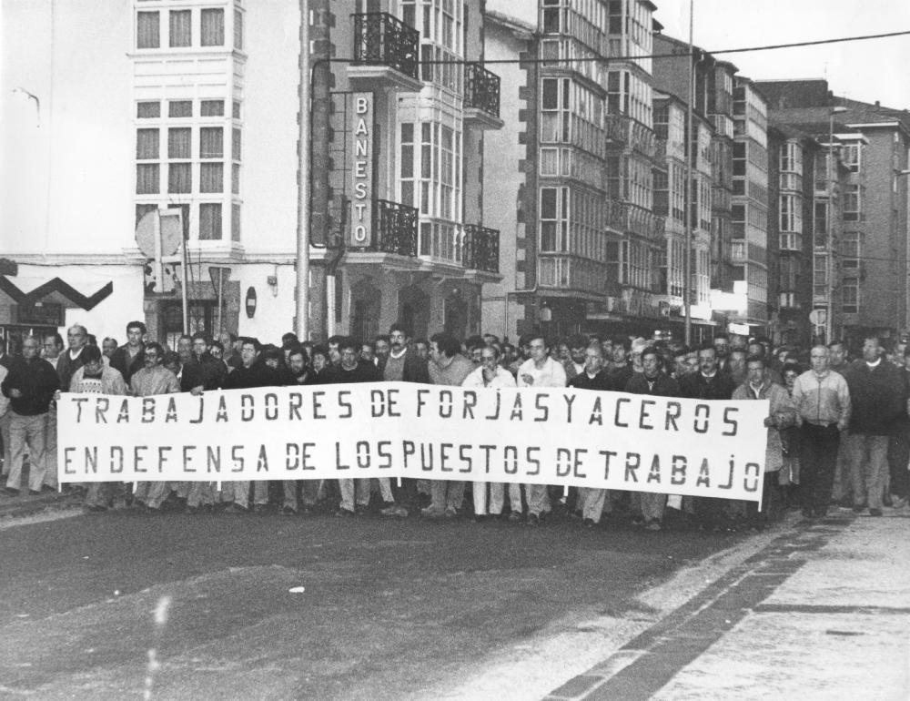

Slide 10
6.4 Artisanal, modern and contemporary industries
Traditional industries (those that had appeared during the first and second industrial revolutions) underwent a crisis in the 1970s with three main consequences:
Reconversion
Reindustrialisation
Relocation/offshoring

Slide 11
6.4 Artisanal, modern and contemporary industries
In developed countries high-tech industries have been established in science parks.
In recently industrialised countries (emerging) big complexes that combine industry with offices have been created.

Slide 12
